Slide 1
Embedded System Introduction
Nishanta Nanda
JKS Cloud Pvt Ltd

Slide 2
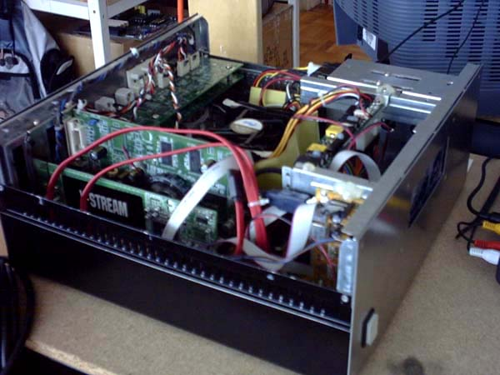
What is an embedded system?
According to the Institution of Electrical Engineers, "A general purpose definition of embedded systems is that they are devices used to control, monitor or assist the operation of equipment, machinery, or plant. 'Embedded' reflects the fact that they are an integral part of the system..." An embedded system is a special-purpose computer system, which is completely encapsulated by the device it controls. An embedded system has specific requirements and performs pre-defined tasks, unlike a general-purpose personal computer.

Slide 3
Microcontrollers and Embedded System
Embedded Systems are a combination of Hardware (microcontrollers) and Software (developed in assembler, c, c++…) designed to perform a specific function
An embedded product uses microcontrollers to do one task and one task only.

Slide 4
What is a Microcontroller?
A microcontroller (often abbreviated MCU) is a single computer chip (integrated circuit) that executes a user program, normally for the purpose of controlling some device, hence the name microcontroller.
The program is normally contained either in a second chip, called an EPROM, or within the same chip as the microcontroller itself.
A microcontroller is normally found in devices such as microwave ovens, automobiles, keyboards, CD players, cell phones, VCRs, security systems, time & attendance clocks, etc.

Slide 5
Microprocessor Vs Microcontroller
Microcontrollers are used in devices that require some amount of computing power but donot require as much computing power as that provided by a complex (and expensive) 486, Pentium, i3 .. system which generally requires a large amount of supporting circuitry (large motherboards, hundreds of megabytes of RAM, hard drives, hard drive controllers, video cards, etc).
A microwave oven just does not need that much computing power.
Microcontroller-based systems are generally smaller, more reliable, and cheaper. They are ideal for the types of applications described above where cost and unit size are very important considerations. In such applications it is almost always desirable to produce circuits that require the smallest number of integrated circuits, that require the smallest amount of physical space, require the least amount of energy, and cost as little as possible.

Slide 6
Microcontroller
Ext int
interrupt
Address Bus (Uni dirctional)
CPU
Data Bus (Bi directional)
Control Lines
OSC

Slide 7
Microcontroller
Ext int
interrupt
Timer0
Timer1
ROM
RAM
CPU
Bus control
4 I/o ports
Serial port
OSC

Slide 8
Simple comparison: Pentium vs. 8051
FEATURE | 8051 | PENTIUM | COMMENT
Clock Speed | 12Mhz. typical but 60MHz. ICs available | 1,000 MHz. (1GHz.) | 8051 internally divides clock by 12 so for 12MHz. clock effective clock rate is just 1MHz.
Address bus | 16 bits | 32 bits | 8051 can address 2¹⁶, or 64Kbytes of memory. Pentium can address 2³², or 4 GigaBytes of memory.
Data bus | 8 bits | 64 bits | Pentium’s wide bus allows very fast data transfers.
ALU width | 8 bits | 32 bits | But - Pentium has multiple 32 bit ALUs – along with floating-point units.
Applications | Domestic appliances, Peripherals, automotive etc. | Personal Computers And other high performance areas.
Power consumption | Small fraction of a watt | Tens of watts | Pentium runs hot as power consumption increases with frequency.
Cost of chip | About RS.52/- | About 6000/-

Slide 9
Microcontroller Manufacturing Companies
There are FOUR major companies manufacturing
8 bit controllers
Motorola (6811)
Intel (8051 MCS51)
Zilog (Z8)
PIC (16X____) Microchip

Slide 10
Port Organization of MCS51
Port 1
P1.0 – P1.7
Port 0
P0.0 – P0.7
P1
P0
Port 3
P3.0 – P3.7
Port 2
P2.0 – P2.7
P3
P2

Slide 11
Port Assignments
Port 0 : Input/Output Port & AD0-AD7 for ext memory
Port 1 : Input/Output Port
Port 2 : Input/Output Port & A8-A15 for ext Memory
Port 3 : Input/Output Port
P3.0 : RxD
P3.1 : TxD
P3.2 : INTO’
P3.3 : INT1’
P3.4 : T0
P3.5 : T1
P3.6 : WR’
P3.7 : RD’

Slide 12
Simple Experiment in Embedded system

Slide 13
A Circuit using 89c51
40
+5V
Pin 40 +vcc
20 Gnd
9 Reset
18 OSC1
19 OSC2
31 Ext Access
9
89c51
31
18
19
GND
20

Slide 14
Burglar alarm system hardware

Slide 15
Input circuit
Output circuit

Slide 16
ALARM_1 Program flow chart

Slide 17
ALARM_1 Program source code
ORG 0000h ; define memory start address 000
; Initialise the I/O ports
MOV P3, #0ffh ; write all ones to P3 to use as an input port
MOV P1, #00 ; all zeros to put P1 in a known output state
POLL:
MOV A, P3 ; read P3 to accumulator
CJNE A, #00h, ALARM ; if not all zeros then jump to ALARM
LJMP POLL ; else loop back to POLL
ALARM:
SETB P1.7 ; enable the BELL by setting P1.7 high
END_LOOP:
LJMP END_LOOP ; program just loops around here
END ; end of program

Slide 18
Hardware circuit with timing diagram for sound

Slide 19
Interactive Vehicle Tracking System
It is a system which can track the vehicles for its movement through out the trip with GPS And GPRS.
The data collected at different data points are stored at the vehicle itself and in the computers of respective data points then to the server.
The Data are
vehicle number, started time, stop time, Fuel at, Date, Fuel type, Qty, Amount, Balance, Driver ID …..
The Data Points are
the places where the interactive RF transmitter and receivers are fixed say BPCL fuel stations.

Slide 20
At the data points
GPS & GPRS based RF transmitter and receivers (RF System) are connected to a computers
GPS system is capable of interacting over area of 1 square metre
The GPS will transmit the data in a periodic interval continuously from the data point

Slide 21
Server
Block diagram of data locker
Receiver
Memory
D i s p l a y
GPS & GPRS
Micro
Controller
Transmitter
sensors
Start/stop
alarm
Load
Fuel

Slide 22
Block diagram of data point
Server
Receiver
GPS & GPRS
SMS
Micro
Controller
Printer
Transmitter
Pump
Pump link circuit

Slide 23
Advantages
Compatible with any SMART cards
Data is stored at data point (fuel station computer) and at the vehicle
Vehicle owners can verify trip data from their office
Data can be online with server
Data can be on auto SMS from vehicle(GSM/CDMA/GPRS)
Owners of the vehicles and dealers are not at the dark, but given with lot of information about their vehicles for analysis
100% automated system

Slide 24
Thank you

